Slide 1


CSC 1706
Probability & Statistics
Dr. Raini Hassan
Office: C2 – 14, Level 2 Department: Computer Science, Level 4, KICT Building
Email: hrai@iium.edu.my Phone no: 03-61965655
Dr. Afidalina Tumian
Office: C4 - 33, Level 4
Department: Computer Science, Level 4, KICT Building
Email: afidalina@iium.edu.my Phone no: 03-61965676

Slide 2

Du’a for Study

Slide 3

Chapter 03:
Data Description

Slide 4
1.1
Data Description
CHAPTER
3
Descriptive and Inferential Statistics
Outline
3-1 | Measures of Central Tendency
3-2 | Measures of Variation
3-3 | Measures of Position
3-4 | Exploratory Data Analysis
Slide 4
Copyright © 2012 The McGraw-Hill Companies, Inc.
Copyright © 2015 The McGraw-Hill Companies, Inc. Permission required for reproduction or display.

Slide 5
Learning Objectives
1 | Summarize data, using measures of central tendency, such as the mean, median, mode, and midrange.
1.1
Descriptive and inferential statistics
2 | Describe data, using measures of variation, such as the range, variance, and standard deviation.
3 | Identify the position of a data value in a data set, using various measures of position, such as percentiles, deciles, and quartiles.
4 | Use the techniques of exploratory data analysis, including boxplots and five-number summaries, to discover various aspects of data.

Slide 6
3.1
Measures of Central Tendency

Slide 7
Introduction
This chapter shows the statistical methods that can be used to summarize data.
The most familiar of these methods is the finding of averages.
Measures of central tendency (mean, median, mode, midrange, and weighted mean)
In addition of knowing the average, how the data values are dispersed must be obtained as well.
The measures that determine the spread of data values.
Measures of variation or measures of dispersion (range, variance, and standard deviation)
The measures that are necessary to describe the data, i.e. they will tell where a specific data value falls within the data set or its relative position in comparison with other data value.
Measures of position (percentiles, deciles, and quartiles)

Slide 8
Introduction (Cont’d)
Traditional Statistics
Average
Variation
Position
What Do We Mean By Average?
Mean
Median
Mode
Midrange
Weighted Mean

Slide 9
3-1 Measures of Central Tendency
A statistic is a characteristic or measure obtained by using the data values from a sample.
A parameter is a characteristic or measure obtained by using all the data values for a specific population.
General Rounding Rule
The basic rounding rule is that rounding should not be done until the final answer is calculated. Use of parentheses on calculators or use of spreadsheets help to avoid early rounding error.

Slide 10
3-1 Measures of Central Tendency: 1. Mean
The mean is the sum of the values, divided by the total number or values.
The symbol (x bar) is used for sample mean.
For a population, the Greek letter μ (mew) is used for the mean.
Where N represents the total number of values in the sample/population.
Rounding Rule: Mean
The mean should be rounded to one more decimal place than that of the raw data.

Slide 11
Chapter 3 Data Description
Section 3-1
Example 3-1
Page #112

Slide 12
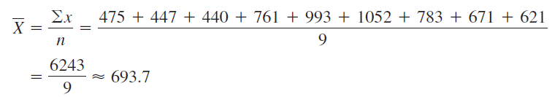
Example 3-1: Police Incidents
The number of calls that a local police department responded to for a sample of 9 months is shown. Find the mean.
475, 447, 440, 761, 993, 1052, 783, 671, 621
The mean number of incidents is 693.7

Slide 13
Mean for Grouped Data
The mean, in most cases, is not an actual data value. For instance, the procedure for finding the mean for grouped data assumes that the mean of all the raw data values in each class is equal to the midpoint of the class.
In reality, this is not true, since the average of the raw data values in each class usually will not be exactly equal to the midpoint.

Slide 14
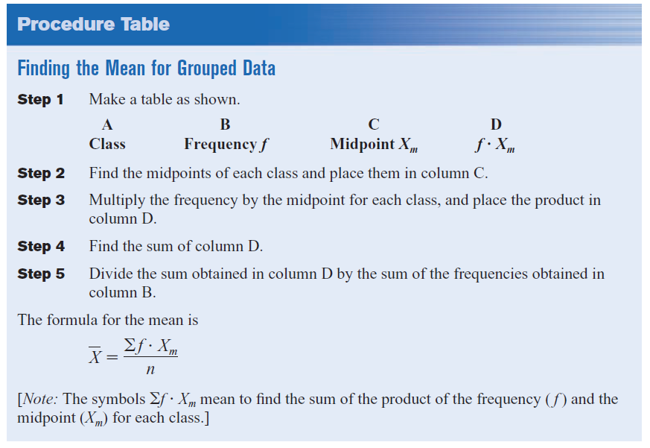
Finding the Mean for Grouped Data
14

Slide 15
Chapter 3 Data Description
Section 3-1
Example 3-3
Page #113

Slide 16
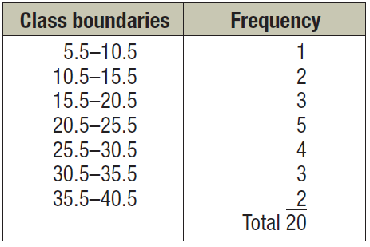
Example 3-3: Miles Run
Below is a frequency distribution of miles run per week. Find the mean.

Slide 17
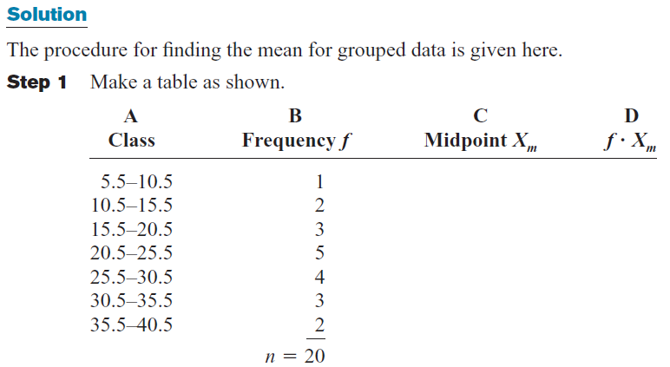
Example 3-3: Miles Run

Slide 18
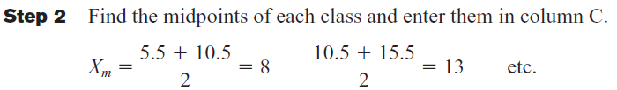
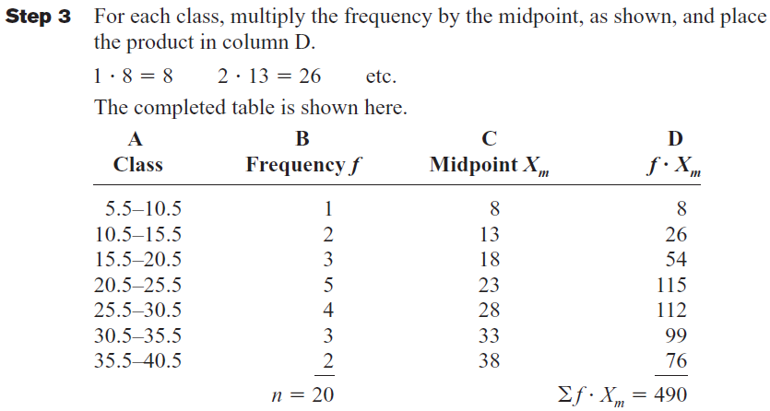
Example 3-3: Miles Run

Slide 19
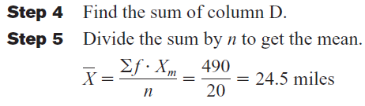
Example 3-3: Miles Run

Slide 20
3-1 Measures of Central Tendency: 2. Median
The median is the midpoint of the data array.
The symbol for the median is MD.

Slide 21
Finding the median
Step 1 Arrange the data values in ascending order.
Step 2 determine the number of values in the data set.
Step 3
If n is odd, select the middle data value as the median.
If n is even, find the mean of the two middle values. That is, add them and divide the sum by 2.
21
Bluman chapter 3

Slide 22
Chapter 3 Data Description
Section 3-1
Example 3-4, 3-5
Page #115

Slide 23
Example 3-4: Police Officers Killed
The number of police officers killed in the line of duty over the last 11 years is shown. Find the median.
177 153 122 141 189 155 162 165 149 157 240
sort in ascending order
122, 141, 149, 153, 155, 157, 162, 165, 177, 189, 240
Select the middle value.
MD = 157
The median is 157 rooms.

Slide 24
Example 3-5: Tornadoes in the U.S.
The number of tornadoes that have occurred in the United States over an 8-year period follows. Find the median.
684, 764, 656, 702, 856, 1133, 1132, 1303
Find the average of the two middle values.
656, 684, 702, 764, 856, 1132, 1133, 1303
The median number of tornadoes is 810.

Slide 25
3-1 Measures of Central Tendency: 3. Mode
The mode is the value that occurs most often in a data set.
It is sometimes said to be the most typical case.
There may be no mode (when no data value occurs more than once), one mode (unimodal), two modes (bimodal), or many modes (multimodal).

Slide 26
Chapter 3 Data Description
Section 3-1
Example 3-6
Page #116

Slide 27
Example 3-6: NFL Signing Bonuses
Find the mode of the signing bonuses of eight NFL players for a specific year. The bonuses in millions of dollars are
18.0, 14.0, 34.5, 10, 11.3, 10, 12.4, 10
You may find it easier to sort first.
10, 10, 10, 11.3, 12.4, 14.0, 18.0, 34.5
Select the value that occurs the most.
The mode is 10 million dollars.

Slide 28
3-1 Measures of Central Tendency: 3. Mode
The mode for grouped data is the modal class.
The modal class is the class with the largest frequency.

Slide 29
Chapter 3 Data Description
Section 3-1
Example 3-9
Page #117

Slide 30
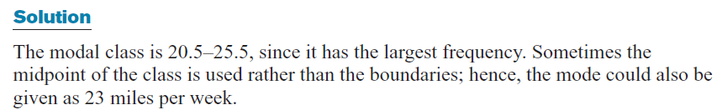
Example 3-9: Miles Run per Week
Find the modal class for the frequency distribution of miles that 20 runners ran in one week.
Class | Frequency
5.5 – 10.5 | 1
10.5 – 15.5 | 2
15.5 – 20.5 | 3
20.5 – 25.5 | 5
25.5 – 30.5 | 4
30.5 – 35.5 | 3
35.5 – 40.5 | 2
The modal class is
20.5 – 25.5.
The mode, the midpoint
of the modal class, is
23 miles per week.

Slide 31
3-1 Measures of Central Tendency: 4. Midrange
The midrange is the average of the lowest and highest values in a data set.

Slide 32
Chapter 3 Data Description
Section 3-1
Example 3-12
Page #119

Slide 33
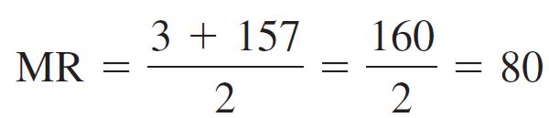
Example 3-12: Bank failures
The number of bank failures for a recent five-year period is shown. Find the midrange.
3, 30, 148, 157, 71
The midrange for the number of bank failures is 80.

Slide 34
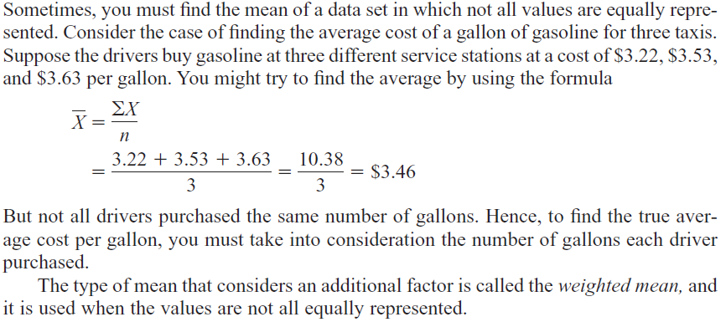
3-1 Measures of Central Tendency: 5. Weighted Mean

Slide 35
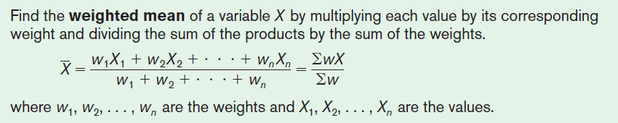
3-1 Measures of Central Tendency: 5. Weighted Mean

Slide 36
Chapter 3 Data Description
Section 3-1
Example 3-14
Page #120

Slide 37
Example 3-17: Grade Point Average
A student received the following grades. Find the corresponding GPA.
Course | Credits, w | Grade, X
English Composition | 3 | A (4 points)
Introduction to Psychology | 3 | C (2 points)
Biology | 4 | B (3 points)
Physical Education | 2 | D (1 point)
The grade point average is 2.7.

Slide 38
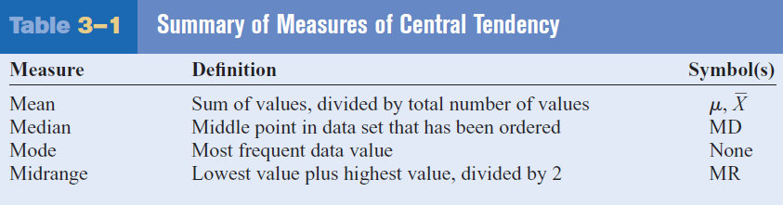
3-1 Summary of Measures of Central Tendency

Slide 39
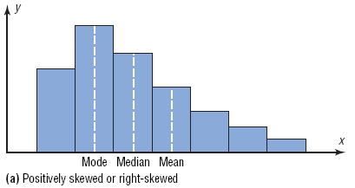
3-1 Distribution Shapes: Positively Skewed or Right-Skewed
The majority of the data values fall to the left of the mean and cluster at the lower end of the distribution; the “tail” is to the right.
The mean is to the right of the median, and the mode is to the left of the median.
E.gs: Incomes of the population in the USA and if the majority of students score poorly on an instructor’s examination.

Slide 40
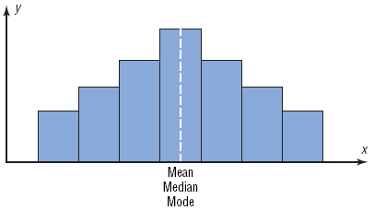
3-1 Distribution Shapes: Symmetric
The data values are evenly distributed on both sides of the mean.
When the distribution is unimodal, the mean, median and mode are the same and are at the center of the distribution.
E.gs: IQ scores and heights of adult males.

Slide 41
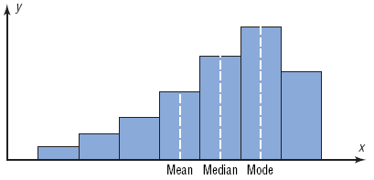
3-1 Distribution Shapes: Negatively Skewed or Left-Skewed
When the majority of the data values fall to the right of the mean and cluster at the upper end of the distribution, with the “tail” to the left.
The mean is to the left of the median, and the mode is to the right of the median.
E.g.: If the majority of students score very high on an instructor’s examination.

Slide 42
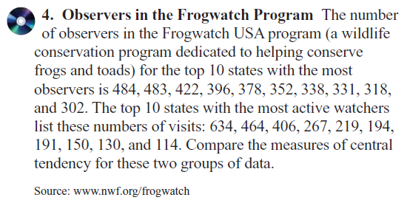
Exercise 3-1
Find the (a) mean, (b) median, (c) mode and (d) midrange.

Slide 43
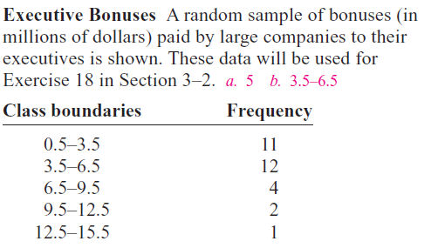
Exercise 3-1 (cont’d)
Find the (a) mean and (b) modal class.
13.

Slide 44
Exercise 3-1 (cont’d)
Find the (a) mean and (b) modal class.

Slide 45
3.2
Measures of Variation

Slide 46
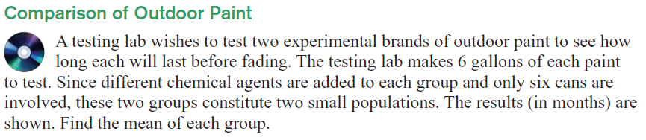
3-2 Measures of Variation
In statistics, to describe the data set accurately, statisticians must know more than the measures of central tendency.

Slide 47
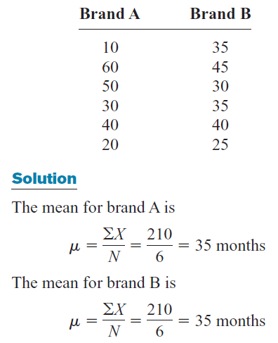
3-2 Measures of Variation

Slide 48
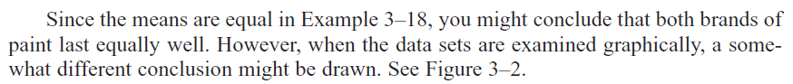
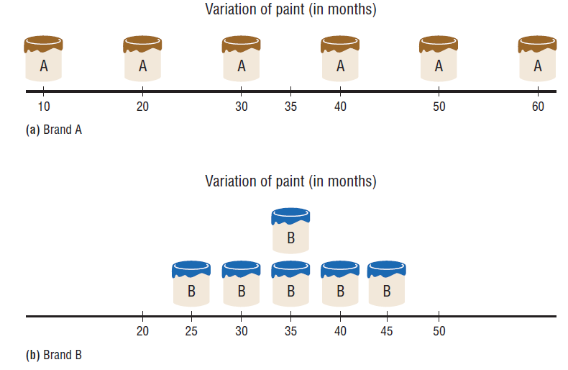
3-2 Measures of Variation

Slide 49
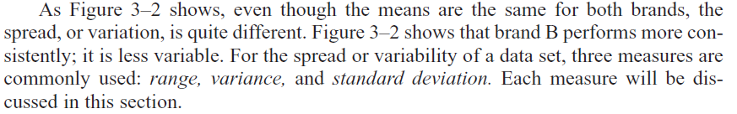
3-2 Measures of Variation

Slide 50
3-2 Measures of Variation: 1. Range
The range is the difference between the highest and lowest values in a data set.

Slide 51
Chapter 3 Data Description
Section 3-2
Example 3-16
Page #129

Slide 52
Example 3-15: Outdoor Paint
Two experimental brands of outdoor paint are tested to see how long each will last before fading. Six cans of each brand constitute a small population. The results (in months) are shown. Find the mean and range of each group.
Brand A | Brand B
10 | 35
60 | 45
50 | 30
30 | 35
40 | 40
20 | 25

Slide 53
Example 3-15: Outdoor Paint
Brand A | Brand B
10 | 35
60 | 45
50 | 30
30 | 35
40 | 40
20 | 25
The average for both brands is the same, but the range
for Brand A is much greater than the range for Brand B.
Which brand would you buy?

Slide 54
3-2 Measures of Variation: 2. Variance & Standard Deviation
The previous example is still showing a large number.
To have a more meaningful statistic to measure the variability, statisticians use measures called the variance and standard deviation.
The population variance is the average of the squares of the distance each value is from the mean.
The standard deviation is the square root of the variance.

Slide 55
3-2 Uses of the Variance and Standard Deviation
To determine the spread of the data.
To determine the consistency of a variable.
To determine the number of data values that fall within a specified interval in a distribution (Chebyshev’s Theorem).
Used in inferential statistics.

Slide 56
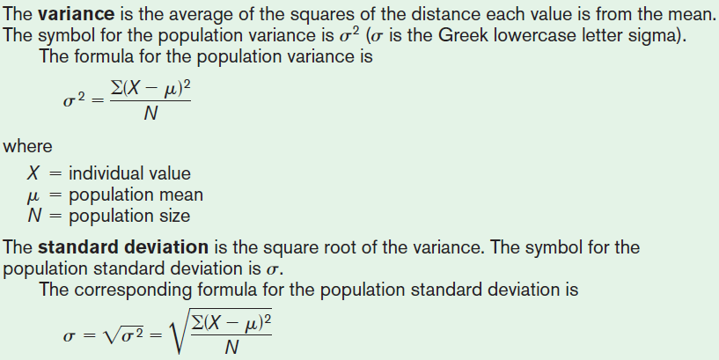
3-2 Measures of Variation: 2. Variance & Standard Deviation (Population Theoretical Model)

Slide 57
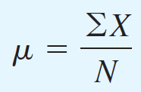
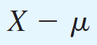
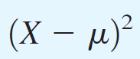
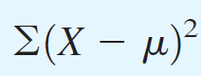
Finding the Population Variance and Population Standard Deviation
Step 1 Find the mean for the data.
Step 2 Find the Deviation for each data value.
Step 3 Square each of the deviations.
Step 4 Find the sum of the squares.
57
Bluman chapter 3

Slide 58
Chapter 3 Data Description
Section 3-2
Example 3-18
Page #131

Slide 59
Example 3-18: Outdoor Paint
Find the variance and standard deviation for the data set for Brand A paint:
10, 60, 50, 30, 40, 20
Months, X | µ | X – µ | (X – µ)²
10 60 50 30 40 20
35
35
35
35
35
35
–25
25
15
–5
5
–15
625
625
225
25
25
225
1750

Slide 60
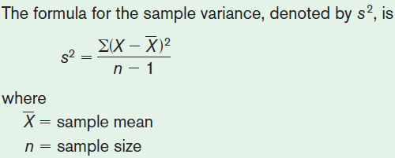
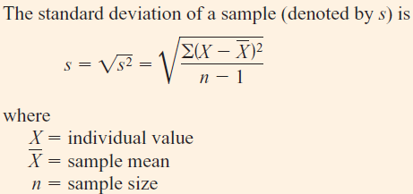
3-2 Measures of Variation: 2. Variance & Standard Deviation (Sample Theoretical Model)

Slide 61
3-2 Measures of Variation: 2. Variance & Standard Deviation (Sample Computational Model)
Is mathematically equivalent to the theoretical formula.
Saves time when calculating by hand
Does not use the mean
Is more accurate when the mean has been rounded.

Slide 62
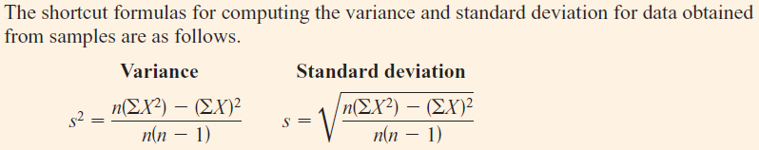
3-2 Measures of Variation: 2. Variance & Standard Deviation (Sample Computational Model)

Slide 63
Chapter 3 Data Description
Section 3-2
Examples on using the shortcut formulas

Slide 64
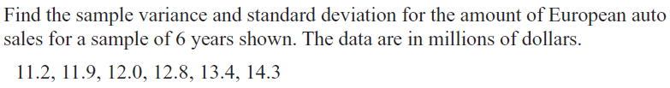
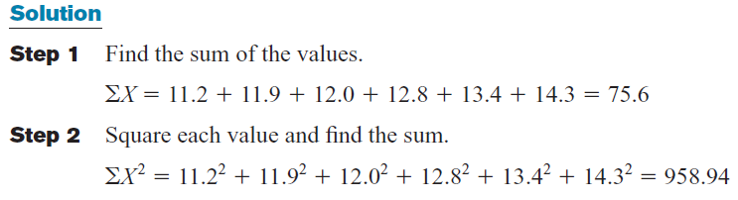
European Auto Sales

Slide 65
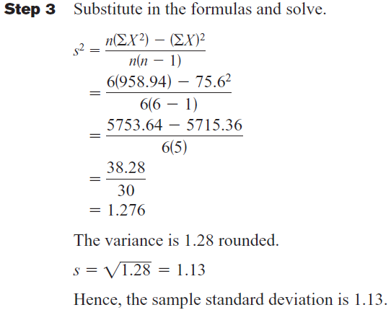
European Auto Sales

Slide 66
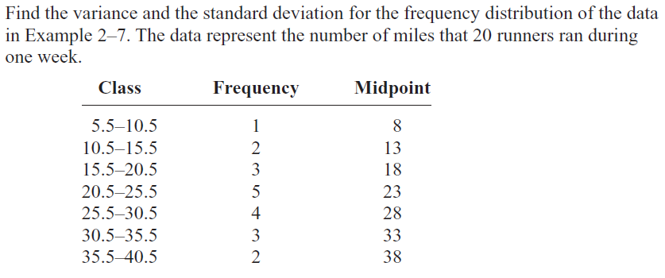
Miles Run Per Week (Grouped Data)

Slide 67
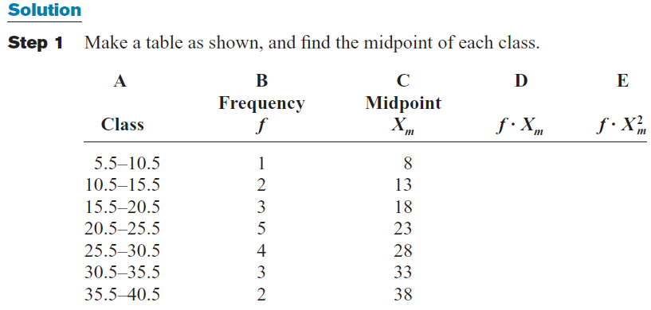
Miles Run Per Week (Grouped Data)

Slide 68
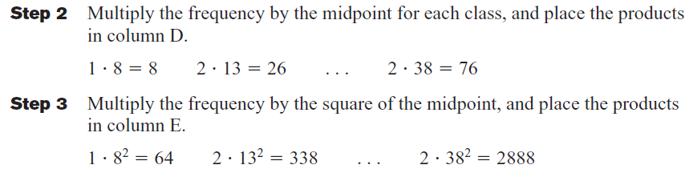
Miles Run Per Week (Grouped Data)

Slide 69
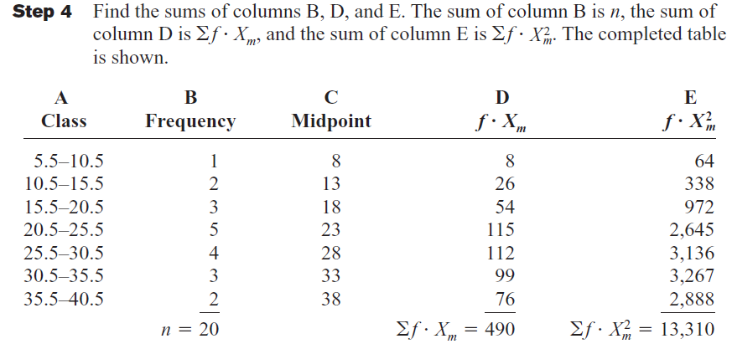
Miles Run Per Week (Grouped Data)

Slide 70
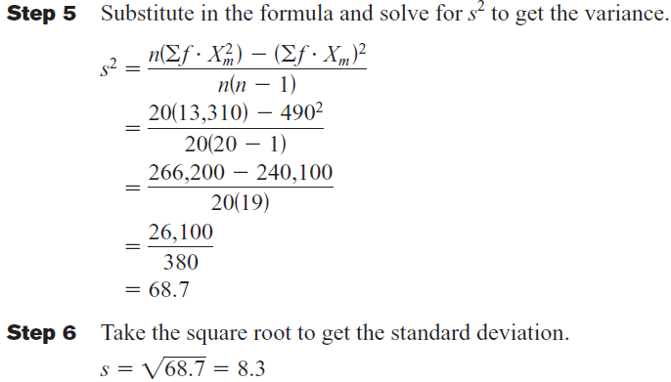
Miles Run Per Week (Grouped Data)

Slide 71
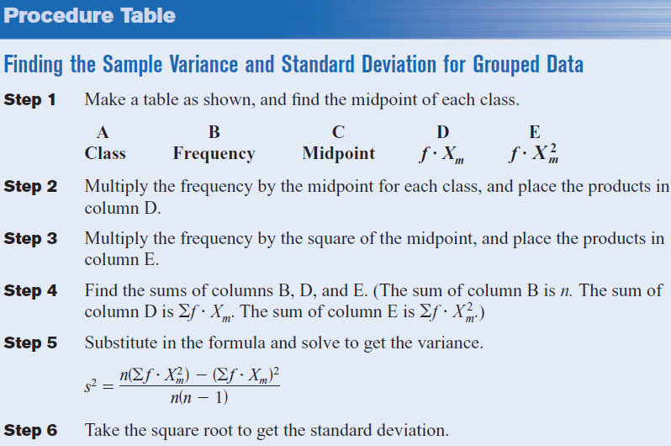

Slide 72
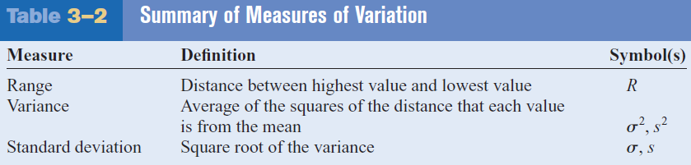
3-2 Summary of Measures of Variation

Slide 73
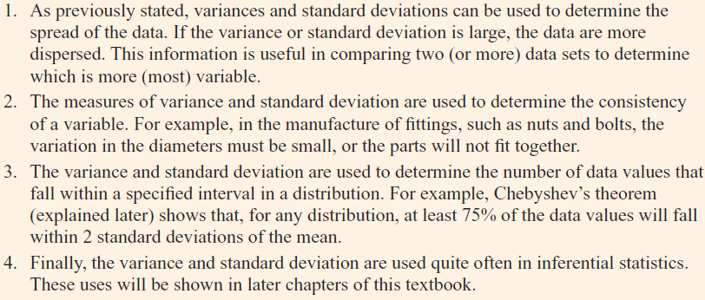
Properties and Uses of the Variance and Standard Deviation

Slide 74
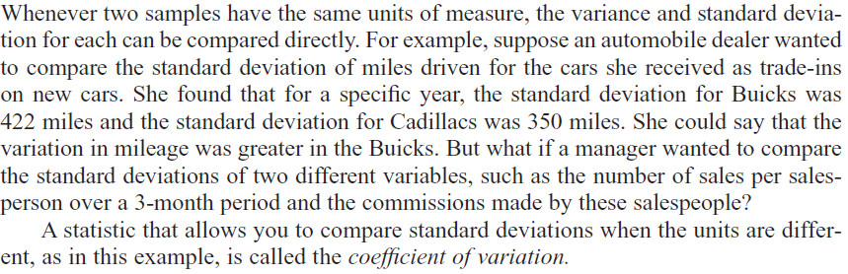
3-2 Measures of Variation: 3. Coefficient of Variation

Slide 75
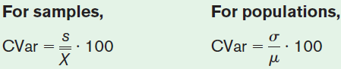
3-2 Measures of Variation: 3. Coefficient of Variation
The coefficient of variation is the standard deviation divided by the mean, expressed as a percentage.
Use CVAR to compare standard deviations when the units are different.

Slide 76
Chapter 3 Data Description
Section 3-2
Example 3-23
Page #138

Slide 77
Example 3-23: Sales of Automobiles
The mean of the number of sales of cars over a 3-month period is 87, and the standard deviation is 5. The mean of the commissions is $5225, and the standard deviation is $773. Compare the variations of the two.
Commissions are more variable than sales.

Slide 78
3-2 Measures of Variation: 4. Range Rule of Thumb
Used to approximate standard deviation.
when the distribution is unimodal and approximately symmetric ONLY.

Slide 79
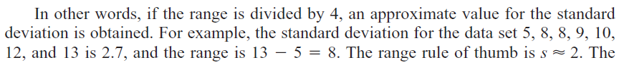
3-2 Measures of Variation: 4. Range Rule of Thumb

Slide 80
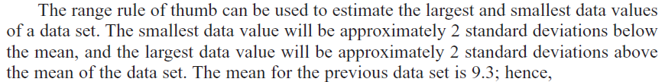
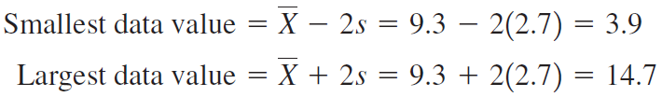
3-2 Measures of Variation: 4. Range Rule of Thumb

Slide 81
3-2 Measures of Variation: 5. Chebyshev’s Theorem
The proportion of values from any data set that fall within k standard deviations of the mean will be at least 1 – 1/k², where k is a number greater than 1 (k is not necessarily an integer).
# of standard deviations, k | Minimum Proportion within k standard deviations | Minimum Percentage within k standard deviations
2 | 1 – 1/4 = 3/4 | 75%
3 | 1 – 1/9 = 8/9 | 88.89%
4 | 1 – 1/16 = 15/16 | 93.75%

Slide 82
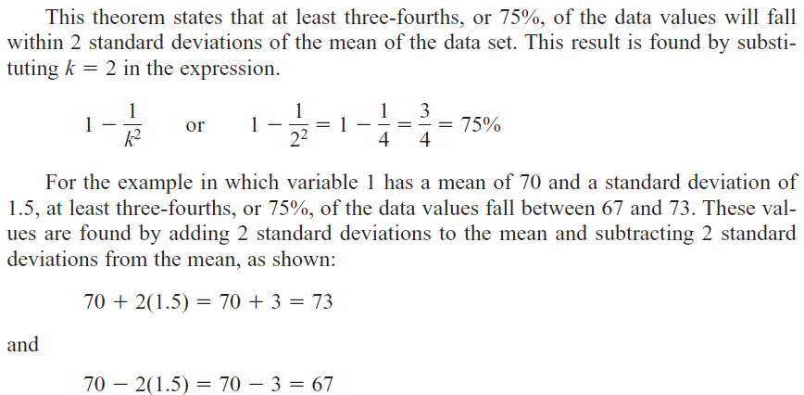
3-2 Measures of Variation: 5. Chebyshev’s Theorem
Variable A; standard deviation = 1.5
Variable B; standard deviation = 10; mean = 70

Slide 83
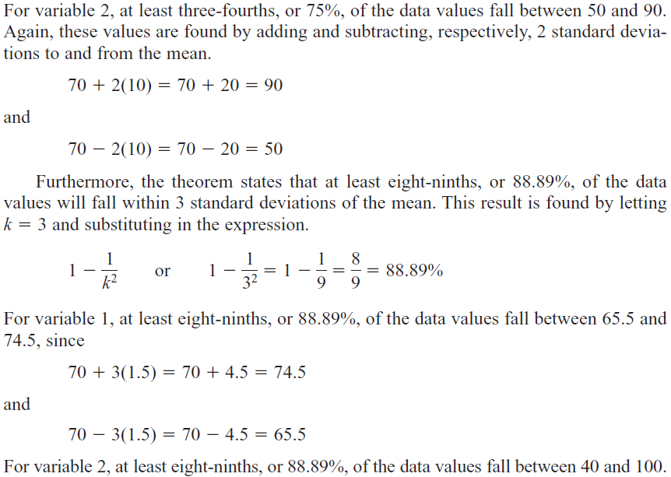
3-2 Measures of Variation: 5. Chebyshev’s Theorem

Slide 84
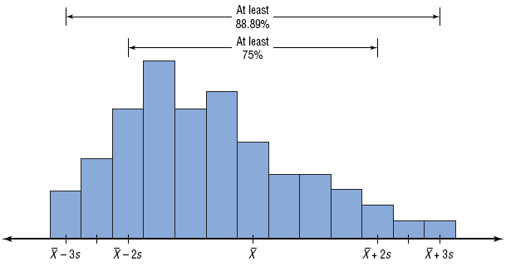
3-2 Measures of Variation: 5. Chebyshev’s Theorem

Slide 85
3-2 Measures of Variation: 5. Chebyshev’s Theorem
NFL Salaries
The salaries (in million of dollars) for 31 NFL teams for a specific season are given in this frequency distribution.
Construct a histogram, find the mean, variance and standard deviation, and lastly find the proportion of values in the data set by using Chebyshev’s theorem.

Slide 86
3-2 Measures of Variation: 5. Chebyshev’s Theorem
Class Limits | Frequency f
39.9 – 42.8 | 2
42.9 – 45.8 | 2
45.9 – 48.8 | 5
48.9 – 51.8 | 5
51.9 – 54.8 | 12
54.9 – 57.8 | 5
Total | 31

Slide 87
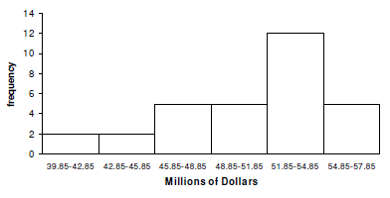
3-2 Measures of Variation: 5. Chebyshev’s Theorem
1. Histogram

Slide 88

3-2 Measures of Variation: 5. Chebyshev’s Theorem
2. Mean, $\overline{X}$ = 1581.85 / 31 = 51.03
Class Limits | Frequency f | Midpoint X_{m} | f . X_{m}
39.9 – 42.8 | 2 | 41.35 | 82.7
42.9 – 45.8 | 2 | 44.35 | 88.7
45.9 – 48.8 | 5 | 47.35 | 236.75
48.9 – 51.8 | 5 | 50.35 | 251.75
51.9 – 54.8 | 12 | 53.35 | 640.2
54.9 – 57.8 | 5 | 56.35 | 281.75
Total | 31 |  | 1581.85

Slide 89
3-2 Measures of Variation: 5. Chebyshev’s Theorem
3. Variance & Standard Deviation
Class Limits | Frequency f | Midpoint X_{m} | f . X_{m} | f . X_{m}²
39.9 – 42.8 | 2 | 41.35 | 82.7 | 3419.645
42.9 – 45.8 | 2 | 44.35 | 88.7 | 3933.845
45.9 – 48.8 | 5 | 47.35 | 236.75 | 11210.1125
48.9 – 51.8 | 5 | 50.35 | 251.75 | 12675.6125
51.9 – 54.8 | 12 | 53.35 | 640.2 | 34154.67
54.9 – 57.8 | 5 | 56.35 | 281.75 | 15876.6125
Total | 31 |  | 1581.85 | 81270.4975

Slide 90

3-2 Measures of Variation: 5. Chebyshev’s Theorem
3. Variance & Standard Deviation
s² = ((31(81270.4975)) - 1581.85²) / 31(31 – 1)
= (2519385.423 – 2502249.423) / 31(30)
= 17136 / 930
= 18.4
s = $\sqrt{18.4}$
= 4.3

Slide 91
3-2 Measures of Variation: 5. Chebyshev’s Theorem
4. Chebyshev’s Theorem
For 75% = 51.03 + 2(4.3)
= 51.03 + 8.6
= 59.63
For 75% = 51.03 - 2(4.3)
= 51.03 - 8.6
= 42.43

Slide 92
3-2 Measures of Variation: 5. Chebyshev’s Theorem
4. Chebyshev’s Theorem
For 88.89% = 51.03 + 3(4.3)
= 51.03 + 12.9
= 63.93
For 88.89% = 51.03 - 3(4.3)
= 51.03 – 12.9
= 38.13

Slide 93
3-2 Measures of Variation: 5. Chebyshev’s Theorem
4. Chebyshev’s Theorem
For 93.75% = 51.03 + 4(4.3)
= 51.03 + 17.2
= 68.23
For 93.75% = 51.03 - 4(4.3)
= 51.03 – 17.2
= 33.83

Slide 94
Chapter 3 Data Description
Section 3-2
Example 3-25
Page #141

Slide 95
Example 3-25: Prices of Homes
The mean price of houses in a certain neighborhood is $50,000, and the standard
deviation is $10,000. Find the price range for which at least 75% of the houses will sell.
Chebyshev’s Theorem states that at least 75% of a data set will fall within 2 standard deviations of the mean.
50,000 – 2(10,000) = 30,000
50,000 + 2(10,000) = 70,000
At least 75% of all homes sold in the area will have a
price range from $30,000 and $70,000.

Slide 96

3-2 Measures of Variation: 6. Empirical Rule (Normal)

Slide 97

3-2 Measures of Variation: 6. Empirical Rule (Normal)

Slide 98
3-2 Measures of Variation: 6. Empirical Rule (Normal)
The percentage of values from a data set that fall within k standard deviations of the mean in a normal (bell-shaped) distribution is listed below.
# of standard deviations, k | Proportion within k standard deviations
1 | 68%
2 | 95%
3 | 99.7%

Slide 99

Exercise 3-2
Find variance and standard deviation.

Slide 100

Exercise 3-2 (cont’d)

Slide 101
3.3
Measures of Position

Slide 102

3-3 Measures of Position

Slide 103
3-3 Measures of Position
Standard scores (or z-score)
Percentiles
Deciles
Quartiles
Interquartile Range (IQR)

Slide 104

3-3 Measures of Position: 1. z-score

Slide 105

3-3 Measures of Position: 1. z-score

Slide 106
Chapter 3 Data Description
Section 3-3
Example 3-27
Page #148

Slide 107
Example 3-27: Test Scores
A student scored 65 on a calculus test that had a mean of 50 and a standard deviation of 10; she scored 30 on a history test with a mean of 25 and a standard deviation of 5. Compare her relative positions on the two tests.
She has a higher relative position in the Calculus class.

Slide 108
3-3 Measures of Position: 2. Percentiles
Percentiles are position measures used in educational and health-related fields to indicate the position of an individual in a group.
Percentiles separate the data set into 100 equal groups.
A percentile rank for a datum represents the percentage of data values below the datum.

Slide 109

3-3 Measures of Position: Example of a Percentile Graph

Slide 110
Chapter 3 Data Description
Section 3-3
Example 3-30
Page #153

Slide 111
Example 3-30: Test Scores
A teacher gives a 20-point test to 10 students. Find the percentile rank of a score of 12.
18, 15, 12, 6, 8, 2, 3, 5, 20, 10
Sort in ascending order.
2, 3, 5, 6, 8, 10, 12, 15, 18, 20
6 values
A student whose score was 12 did better than 65% of the class.

Slide 112
Chapter 3 Data Description
Section 3-3
Example 3-32
Page #154

Slide 113
Example 3-32: Test Scores
A teacher gives a 20-point test to 10 students. Find the value corresponding to the 25th percentile.
18, 15, 12, 6, 8, 2, 3, 5, 20, 10
1. Sort in ascending order.
2, 3, 5, 6, 8, 10, 12, 15, 18, 20
2. 2, 3, 5, 6, 8, 10, 12, 15, 18, 20
The value 5 corresponds to the 25th percentile.

Slide 114


Slide 115
3-3 Measures of Position: 3. Deciles and 4. Quartiles
Deciles separate the data set into 10 equal groups. D₁=P₁₀, D₄=P₄₀
Quartiles separate the data set into 4 equal groups. Q₁=P₂₅, Q₂=MD, Q₃=P₇₅

Slide 116

3-3 Measures of Position: 3. Deciles

Slide 117

3-3 Measures of Position: 4. Quartiles

Slide 118


Slide 119
Chapter 3 Data Description
Section 3-3
Example 3-34
Page #156

Slide 120
Example 3-34: Quartiles
Find Q₁, Q₂, and Q₃ for the data set.
15, 13, 6, 5, 12, 50, 22, 18
Sort in ascending order.
5, 6, 12, 13, 15, 18, 22, 50

Slide 121

3-3 Measures of Position: 5. Interquartile Range (IQR)
The Interquartile Range, IQR = Q₃ – Q₁.

Slide 122

Summary of Position Measures

Slide 123
3-3 Outliers
A data set should be checked for extremely high and or extremely low values.
These values are called outliers.
In specific, an outlier is an extremely high or low data value when compared with the rest of the data values.

Slide 124

3-3 Outliers

Slide 125

3.3 Outliers (Example)

Slide 126

Exercise 3-3

Slide 127
3.4
Exploratory Data Analysis

Slide 128

3-4 Exploratory Data Analysis

Slide 129
3-4 Exploratory Data Analysis
The Five-Number Summary is composed of the following numbers: Low, Q₁, MD, Q₃, High
The Five-Number Summary can be graphically represented using a Boxplot.

Slide 130
Constructing Boxplots
Find the five-number summary.
Draw a horizontal axis with a scale that includes the maximum and minimum data values.
Draw a box with vertical sides through Q₁ and Q₃, and draw a vertical line though the median.
Draw a line from the minimum data value to the left side of the box and a line from the maximum data value to the right side of the box.

Slide 131

Information Obtained from a Boxplot

Slide 132
Chapter 3 Data Description
Section 3-4
Example 3-37
Page #169

Slide 133
Example 3-37: Meteorites
The number of meteorites found in 10 U.S. states is shown. Construct a boxplot for the data.
89, 47, 164, 296, 30, 215, 138, 78, 48, 39
30, 39, 47, 48, 78, 89, 138, 164, 215, 296
Five-Number Summary: 30-47-83.5-164-296
Low
Q₁
MD
Q₃
High
47
83.5
164
30
296

Slide 134

3-4 Traditional versus EDA Techniques

Slide 135

Exercise 3-4

Slide 136


Important Formulas - 1

Slide 137


Important Formulas - 2

Slide 138


Important Formulas - 3

